Slide 1
Classification of Diabetes Risk
Predictive Modelling
Shara Soumya

Slide 2
INTRODUCTION
The Goal of this project is to classify the status of Diabetes for the patients admitted in ICU who could be unresponsive or in critical condition.
Background:
Getting a rapid understanding of the context of a patient’s overall health has been particularly important during the COVID-19 pandemic. A patient in distress or a patient who is brought in confused or unresponsive may not be able to provide information about chronic conditions such as heart disease, injuries, or diabetes. Knowledge about chronic conditions such as diabetes can inform clinical decisions about patient care and ultimately improve patient outcomes.

Slide 3
Data Source:
The dataset for the project has been taken from the following link:
https://www.kaggle.com/c/widsdatathon2021/data, by WiDS Worldwide team at Stanford.
This data pertains to a hackathon challenge that focuses on models to determine whether a patient admitted to ICU has been diagnosed with a particular type of diabetes, diabetes mellitus. Using data from the first 24 hours of Intensive Care, labeled data is used for model development.

Slide 4
About the Data:
The dataset is huge with 130157 rows and 181 columns – this is the data considered for this project
Evaluation Metric:
The metric considered for evaluation in this project is Area under Receiver Operating Characteristic (AUC) between the Actual target and Predicted value.

Slide 5
Data Preprocessing
Missing Values:
74 columns in the data with more than 50% Null values – dropped
1 column with all 0 values – dropped
Rest of the columns – Demographic variables like height, bmi, weight are grouped by ethnicity and gender. Other columns are grouped by diabetes status individually.
Numeric Data – Replaced by grouped mean when the mean of the groups is significantly different, else by overall mean / median in case of outliers
Categorical Data – Replaced by grouped mode when there is significant difference, else by overall mode

Slide 6
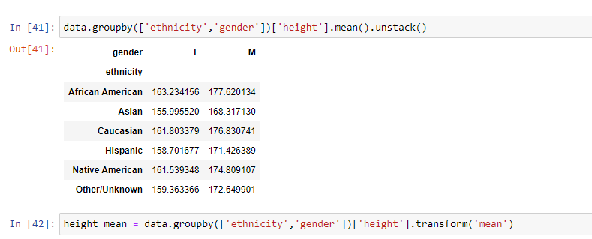
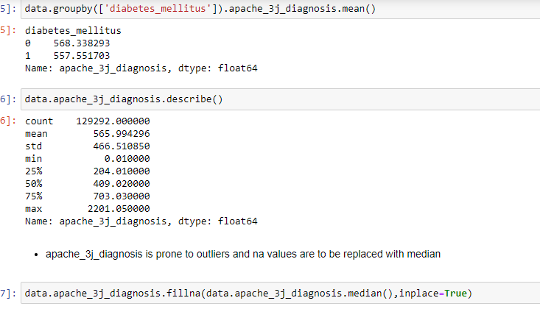
Demographic Variable
Body Vitals

Slide 7
Feature Selection and Engineering
Each of the biological vitals data is given as max and min values in 2 different columns – 2 individual columns are merged to 1 as range
Glasgow coma scale - gcs score is obtained by adding eye, verbal and motor responses which are given as 3 different columns
Pairs of columns that are highly correlated with > 0.7 correlation value are dealt by dropping less important ones.
Exploratory Data Analysis
Vital values obtained by invasive and non-invasive procedure have most similar descriptive statistics – columns with more missing values are dropped

Slide 8
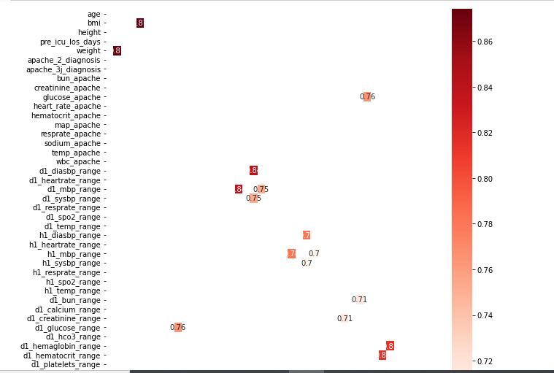

Slide 9
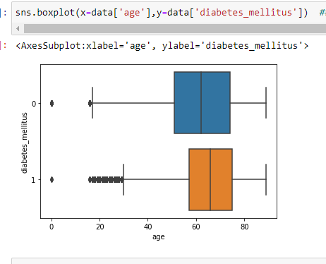
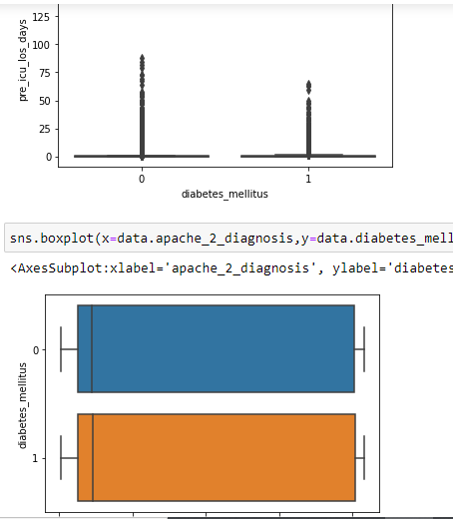
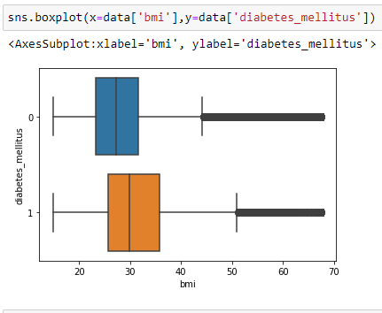

Slide 10
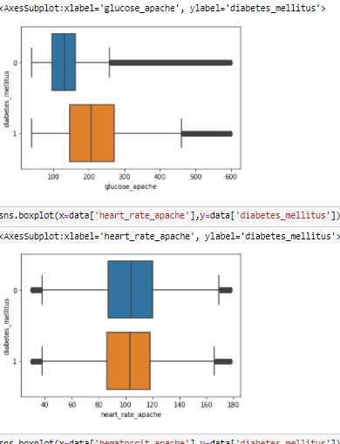
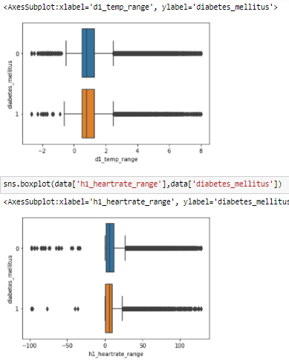

Slide 11
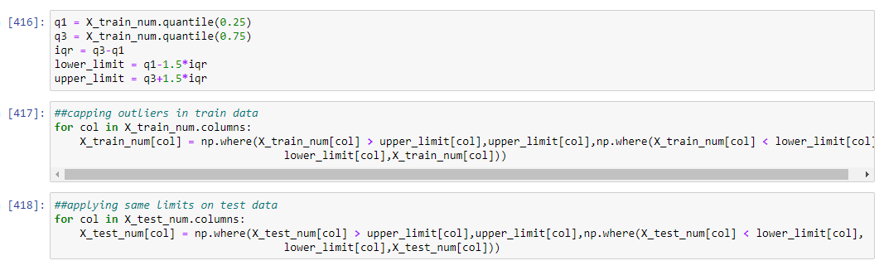
By the end of the EDA, the number of columns in the data came down from 181 to 55
Data Split – After EDA, the data was split to training and testing data
Outlier Treatment
IQR based capping of outliers on train data, applied same border values on test data

Slide 12
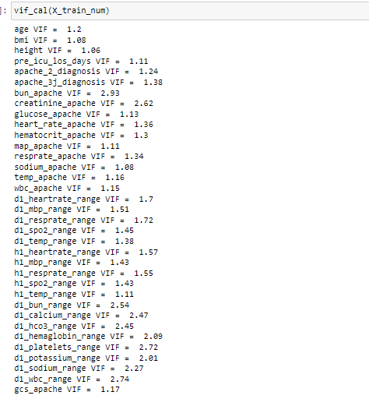
Checked for MultiCollinearity among numeric variables using VIF

Slide 13
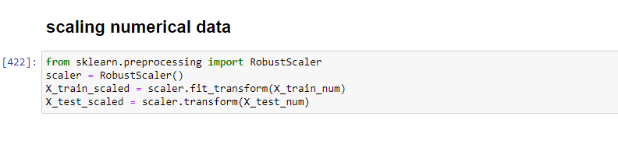
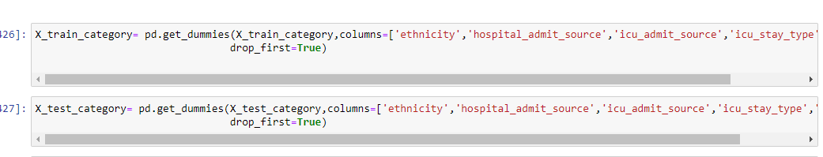
Scaling – Robust Scaling used to scale numeric data
One Hot Encoding – Categorical Data is one hot encoded with pandas get dummies function

Slide 14
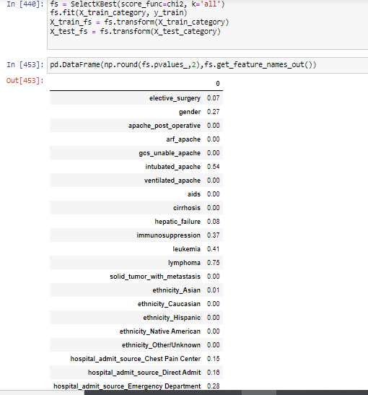
After One Hot Encoding, data has 81 columns
Chi-Square Test of Independence between each of the categorical variable and Diabetes Mellitus status to find significant categorical data, P<0.05 - Significant

Slide 15
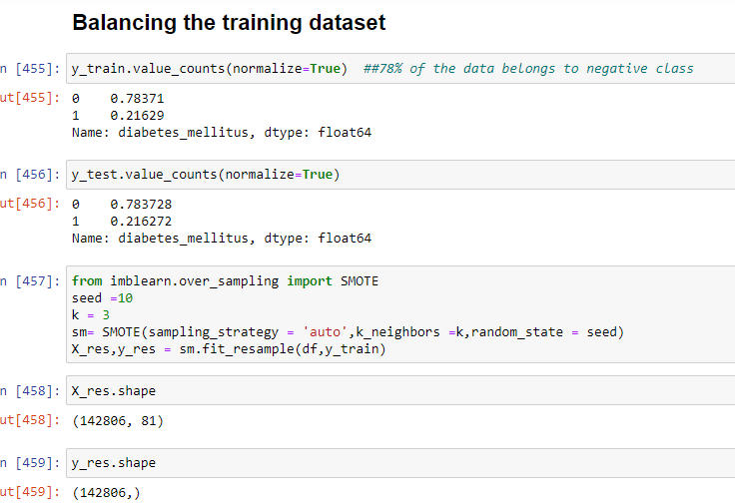
Balancing of Imbalanced Data set – Data is highly imbalanced with approximately 78% data belonging to negative class. SMOTE oversampling is applied to balance the training dataset only

Slide 16
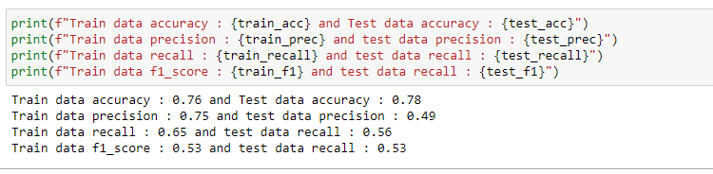
Model Building
Logistic Regression:
40 variables were selected based on their significance/p-values for modelling
Base Model stats:

Slide 17
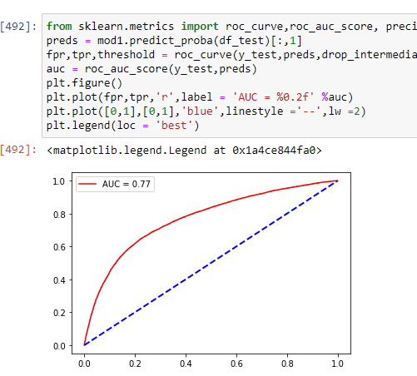
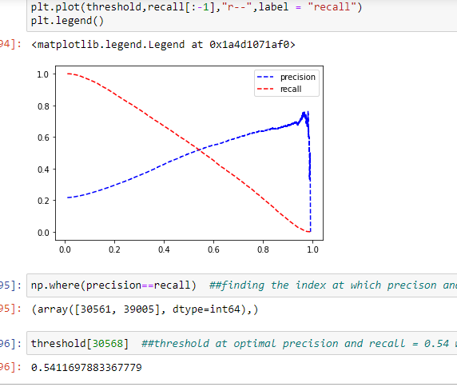
Optimal Threshold : 0.54 based on precision-recall curve
AUC_Score : 0.77

Slide 18
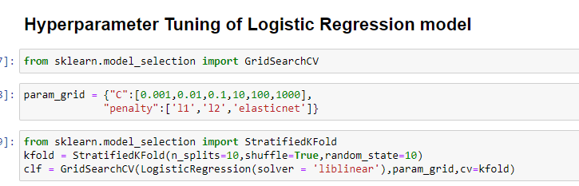
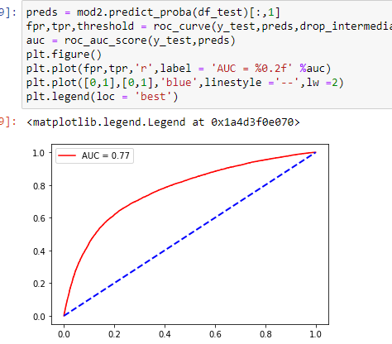
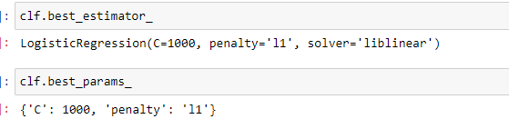
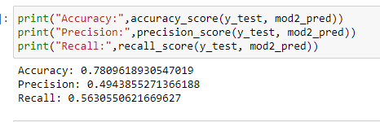
HyperParameterTuning – No Improvement

Slide 19
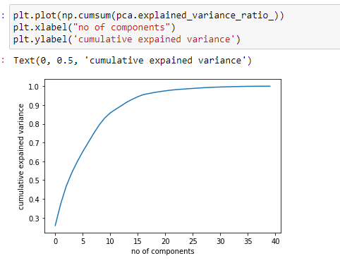
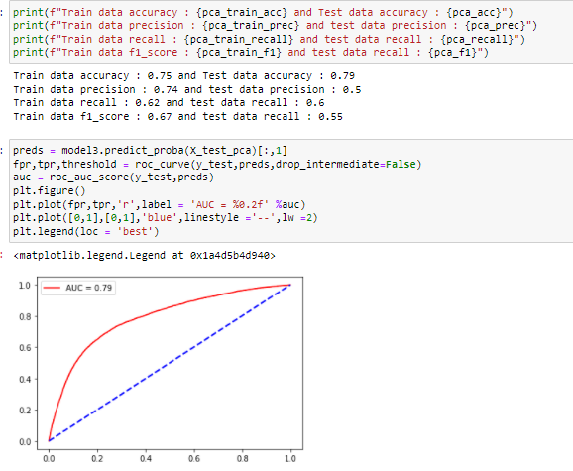
PCA – Logistic Regression with PCA showed slight Improvement in AUC to 0.79
15 pca components could explain about 95% of variance in the data

Slide 20
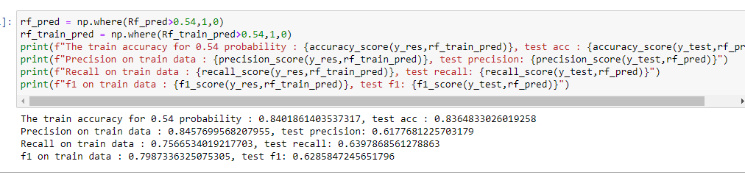
Random Forest with HyperParameterTuning
Model built with Best Params selected from Hyperparameter tuning, resulted in good improvement over Logistic Model
AUC Jumped from 0.79 to 0.88

Slide 21
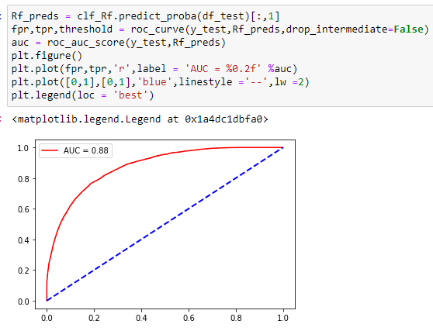
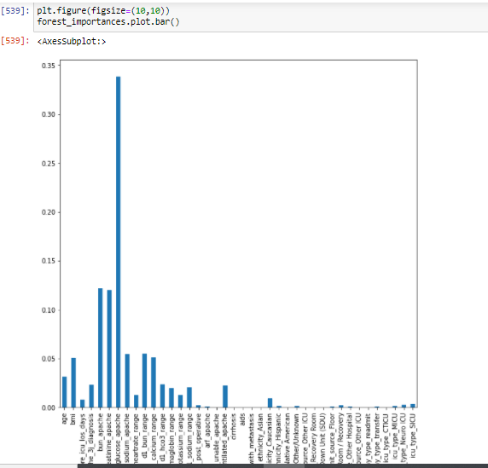
Feature Importance : Only 15 of the 40 variables are shown to be important, with the most important feature being Glucose_apache. Filtered out less significant ones

Slide 22
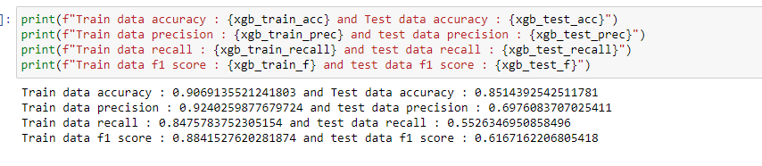
XGBoost Classification with HyperParameterTuning
Slight Improvement in AUC over RandomForest, but way faster compared to RandomForest.
Precision improved well, but there is a fall in recall-score.

Slide 23
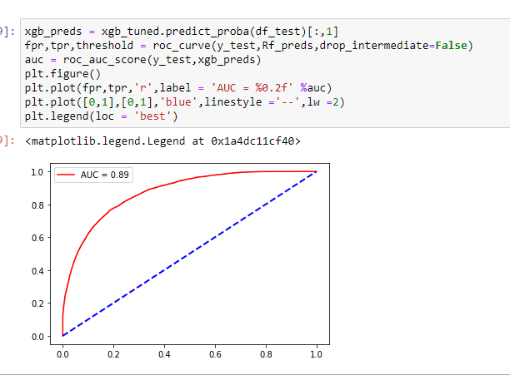
AUC = 0.89

Slide 24
Neural Networks
Tried building neural network, but the accuracy was below average.
Conclusion:
Both Random Forest and XGBoost improved the model performance, but XGBoost is quite fast, given the size of the dataset.

Slide 25


